Slide 1
Topic: Probability Distribution and Sampling Theory
By
Group No. 7
55_Adnan Shaikh
31_Kanchan Mengune
38_Binitdev Pandey
03_Zeeshan Ansari
Under the guidance of
Prof. Vasudeo Nazirkar

Slide 2
Introduction
A sample in a statistics is a small section selected from a large population.
It is essential that a sample must be a random selection so that each member of the population has the same chance of being included in the sample. Thus the fundamental assumption underlying theory of sampling is Random sampling.
A special case of random sampling in which each event has the same probability of success and the chance of success of different events are independent whether previous trials have been made or not, is known as simple sampling.
If a sample quantity is greater thirty then it is consider to be a large sample.
A large sample is assumed to be normal.
By testing our Hypothesis for a large sample we can predict many things about the original population.

Slide 3
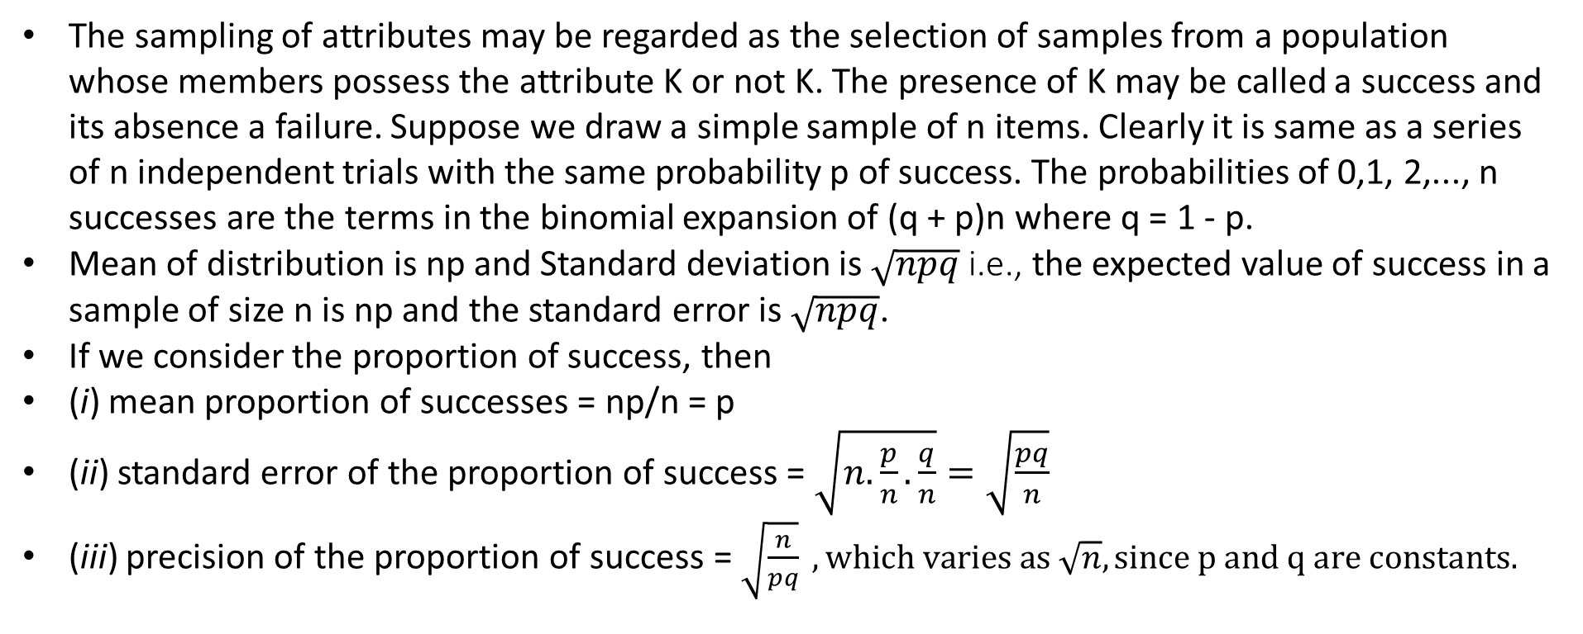
SIMPLE SAMPLING OF ATTRIBUTES
The sampling of attributes may be regarded as the selection of samples from a population whose members possess the attribute K or not K. The presence of K may be called a success and its absence a failure. Suppose we draw a simple sample of n items. Clearly it is same as a series of n independent trials with the same probability p of success. The probabilities of 0,1, 2,..., n successes are the terms in the binomial expansion of (q + p)n where q = 1 - p.
Mean of distribution is np and Standard deviation is $\sqrt{npq}$ i.e., the expected value of success in a sample of size n is np and the standard error is $\sqrt{npq}$.
If we consider the proportion of success, then
(i) mean proportion of successes = np/n = p
(ii) standard error of the proportion of success = $\sqrt{n.\frac{p}{n}.\frac{q}{n}}=\sqrt{\frac{pq}{n}}$
(iii) precision of the proportion of success = $\sqrt{\frac{n}{pq}} , which varies as \sqrt{n}, since p and q are constants.$

Slide 4
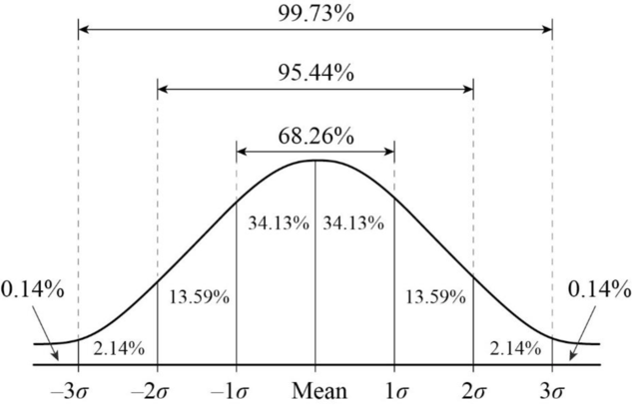
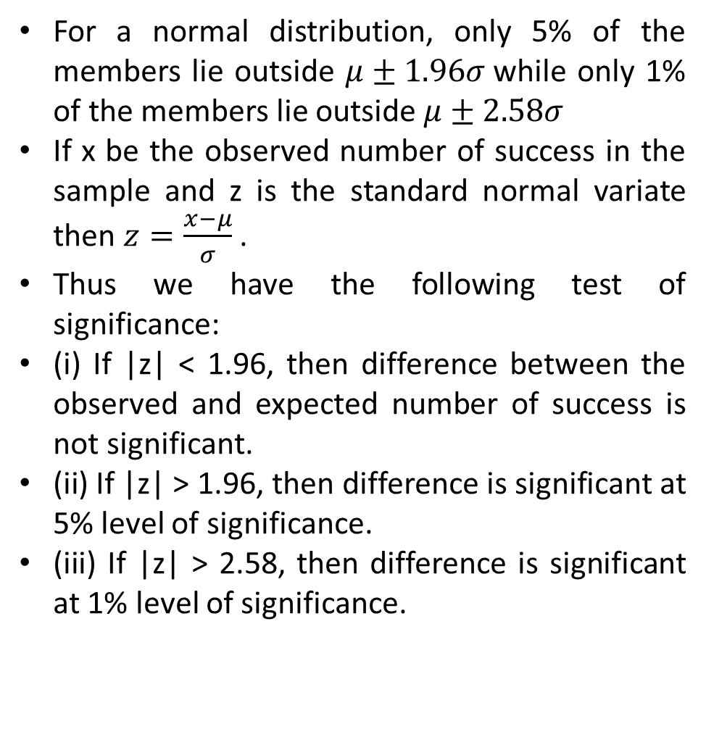
TEST OF SIGNIFICANCE OF LARGE SAMPLES
For a normal distribution, only 5% of the members lie outside $μ±1.96σ$while only 1% of the members lie outside $μ±2.58σ$
If x be the observed number of success in the sample and z is the standard normal variate then $z=\frac{x−μ}{σ}$ .
Thus we have the following test of significance:
(i) If |z| < 1.96, then difference between the observed and expected number of success is not significant.
(ii) If |z| > 1.96, then difference is significant at 5% level of significance.
(iii) If |z| > 2.58, then difference is significant at 1% level of significance.

Slide 5
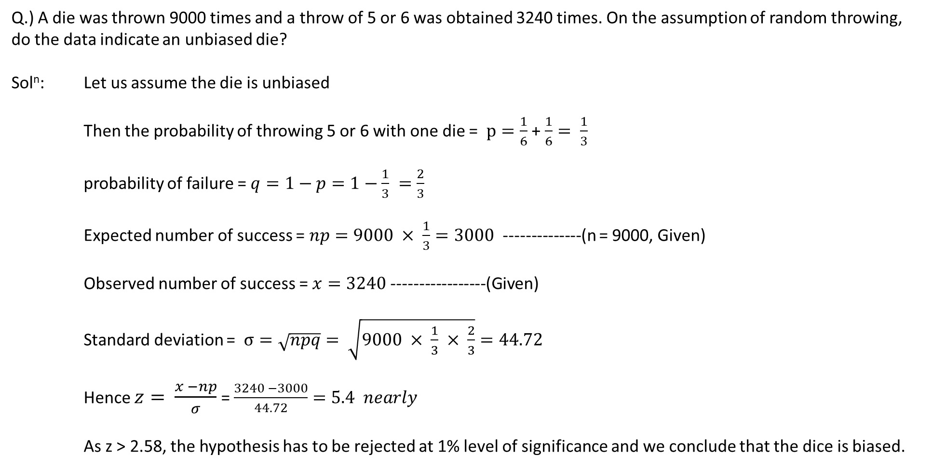
Example:
Q.) A die was thrown 9000 times and a throw of 5 or 6 was obtained 3240 times. On the assumption of random throwing, do the data indicate an unbiased die?
Sol^{n}: Let us assume the die is unbiased
Then the probability of throwing 5 or 6 with one die = $p=\frac{1}{6}$ + $\frac{1}{6}= \frac{1}{3}$
probability of failure = $q=1−p=1−\frac{1}{3} =\frac{2}{3}$
Expected number of success = $np=9000 × \frac{1}{3}=3000$ --------------(n = 9000, Given)
Observed number of success = $x=3240$-----------------(Given)
Standard deviation = $σ=\sqrt{npq}= \sqrt{9000 × \frac{1}{3} × \frac{2}{3}}=44.72$
Hence $z= \frac{x −np}{σ}$ = $\frac{3240 −3000}{44.72}=5.4 nearly$
As z > 2.58, the hypothesis has to be rejected at 1% level of significance and we conclude that the dice is biased.

Slide 6
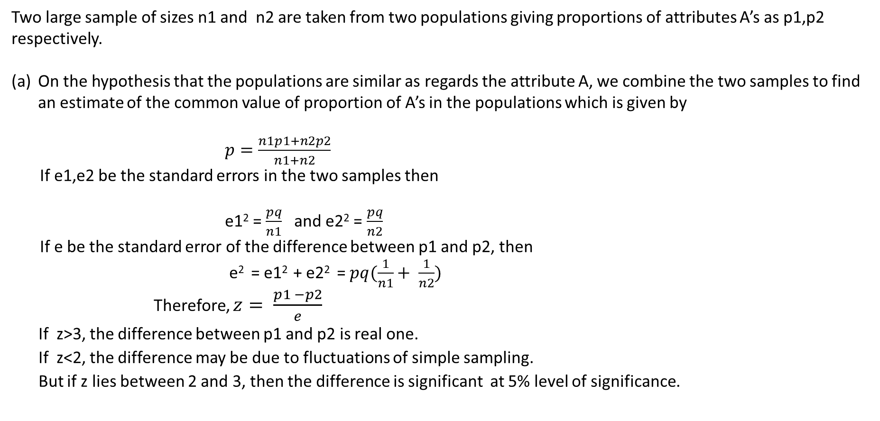
COMPARISON OF LARGE SAMPLES
Two large sample of sizes n1 and n2 are taken from two populations giving proportions of attributes A’s as p1,p2 respectively.
On the hypothesis that the populations are similar as regards the attribute A, we combine the two samples to find an estimate of the common value of proportion of A’s in the populations which is given by
$p=\frac{n1p1+n2p2}{n1+n2}$
If e1,e2 be the standard errors in the two samples then
e1² = $\frac{pq}{n1}$ and e2² = $\frac{pq}{n2}$
If e be the standard error of the difference between p1 and p2, then
e² = e1² + e2² = $pq(\frac{1}{n1}+ \frac{1}{n2})$
Therefore, $z= \frac{p1 −p2}{e}$
If z>3, the difference between p1 and p2 is real one.
If z<2, the difference may be due to fluctuations of simple sampling.
But if z lies between 2 and 3, then the difference is significant at 5% level of significance.

Slide 7
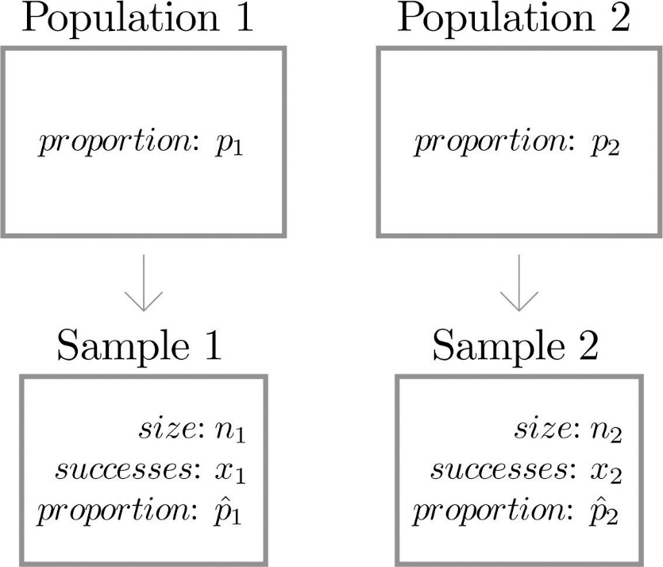
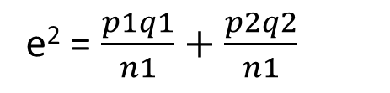
(b) If the proportions of A’s are not the same in the two populations from which the samples are drawn, but p1 and p2 are true values of proportions then S.E. e of the difference p1-p2 is given by
e² = $\frac{p1q1}{n1}+\frac{p2q2}{n1}$
If $z= \frac{p1 −p2}{e}$ < 3, the difference could have arisen due to fluctuations of simple sampling.

Slide 8
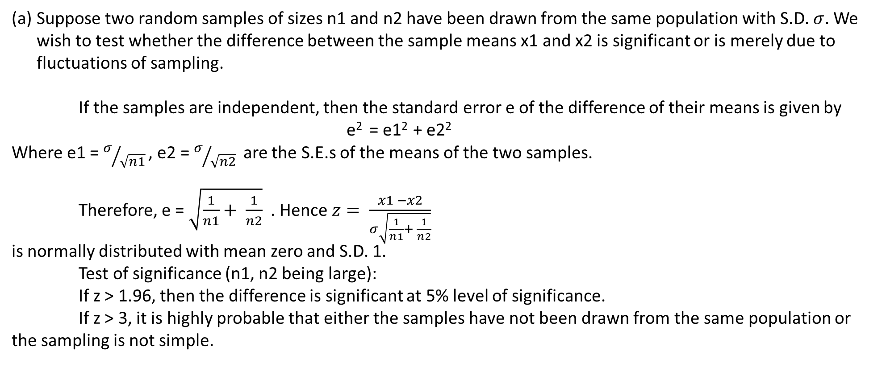
TEST OF SIGNIFICANCE FOR MEANS OF TWO LARGE SAMPLES
Suppose two random samples of sizes n1 and n2 have been drawn from the same population with S.D. $σ$. We wish to test whether the difference between the sample means x1 and x2 is significant or is merely due to fluctuations of sampling.
If the samples are independent, then the standard error e of the difference of their means is given by
e² = e1² + e2²
Where e1 = $σ/{\sqrt{n1} }$, e2 = $σ/{\sqrt{n2} }$ are the S.E.s of the means of the two samples.
Therefore, e = $\sqrt{\frac{1}{n1}+ \frac{1}{n2}}$ . Hence $z= \frac{x1 −x2}{σ\sqrt{\frac{1}{n1}+ \frac{1}{n2}}}$
is normally distributed with mean zero and S.D. 1.
Test of significance (n1, n2 being large):
If z > 1.96, then the difference is significant at 5% level of significance.
If z > 3, it is highly probable that either the samples have not been drawn from the same population or the sampling is not simple.

Slide 9
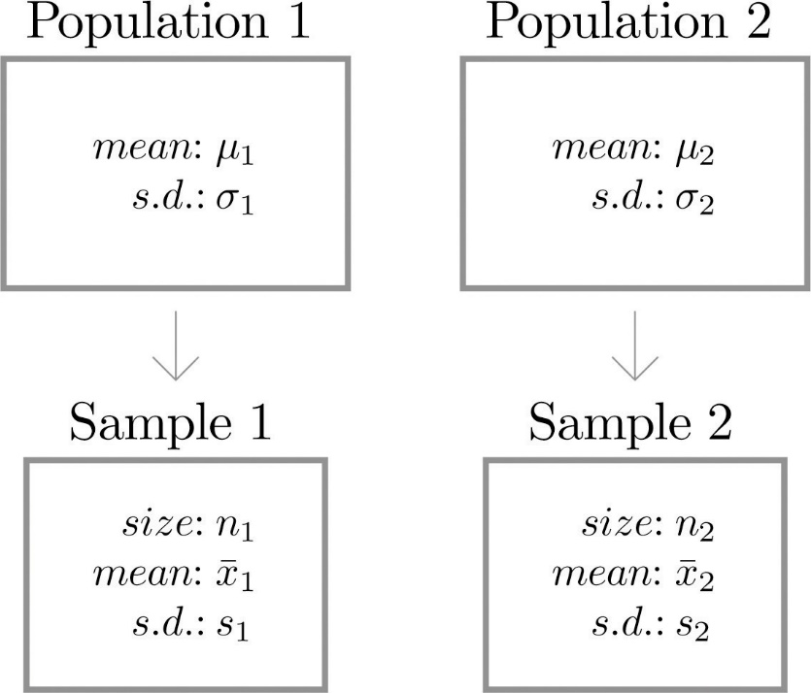
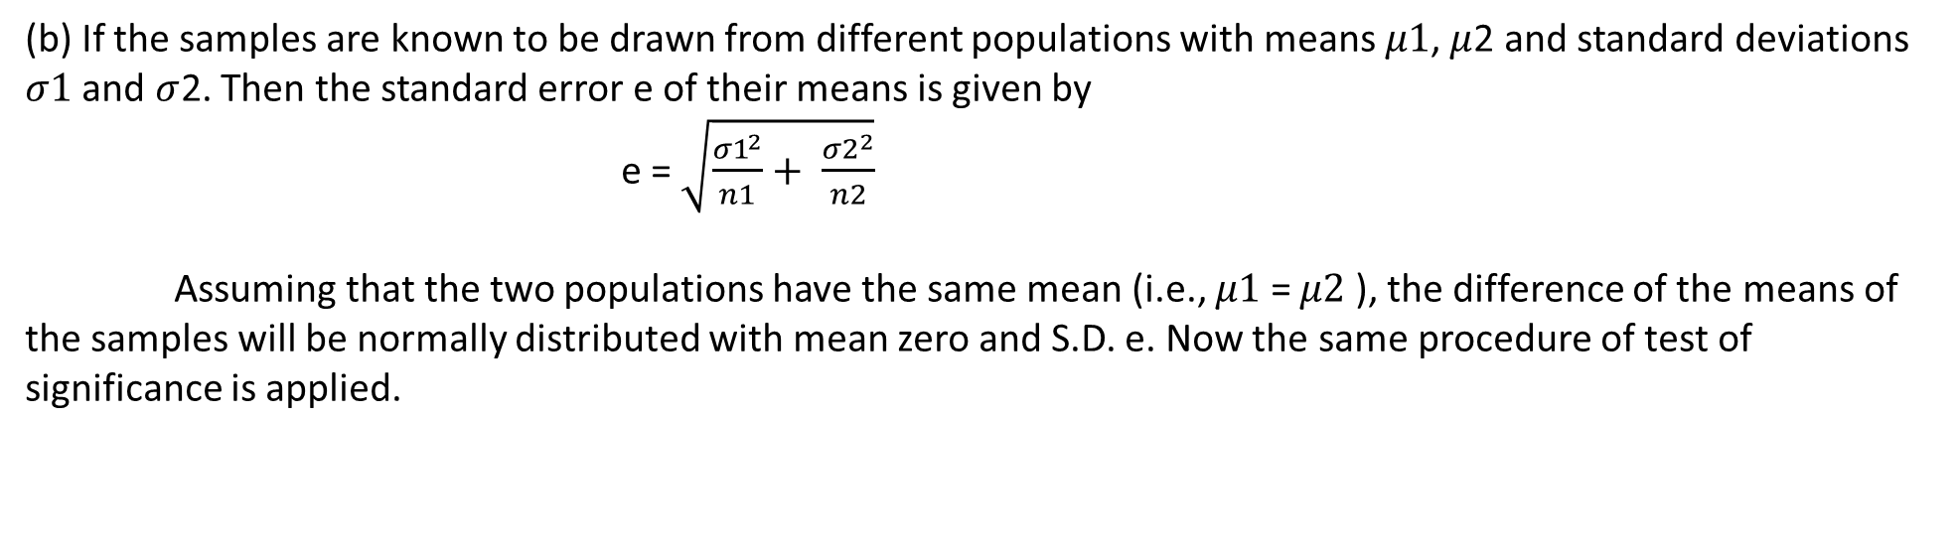
(b) If the samples are known to be drawn from different populations with means $μ1$, $μ$2 and standard deviations $σ1$ and $σ$2. Then the standard error e of their means is given by
e = $\sqrt{\frac{{σ1}^{2}}{n1}+ \frac{{σ2}^{2}}{n2}}$
Assuming that the two populations have the same mean (i.e., $μ1$ = $μ2$ ), the difference of the means of the samples will be normally distributed with mean zero and S.D. e. Now the same procedure of test of significance is applied.

Slide 10
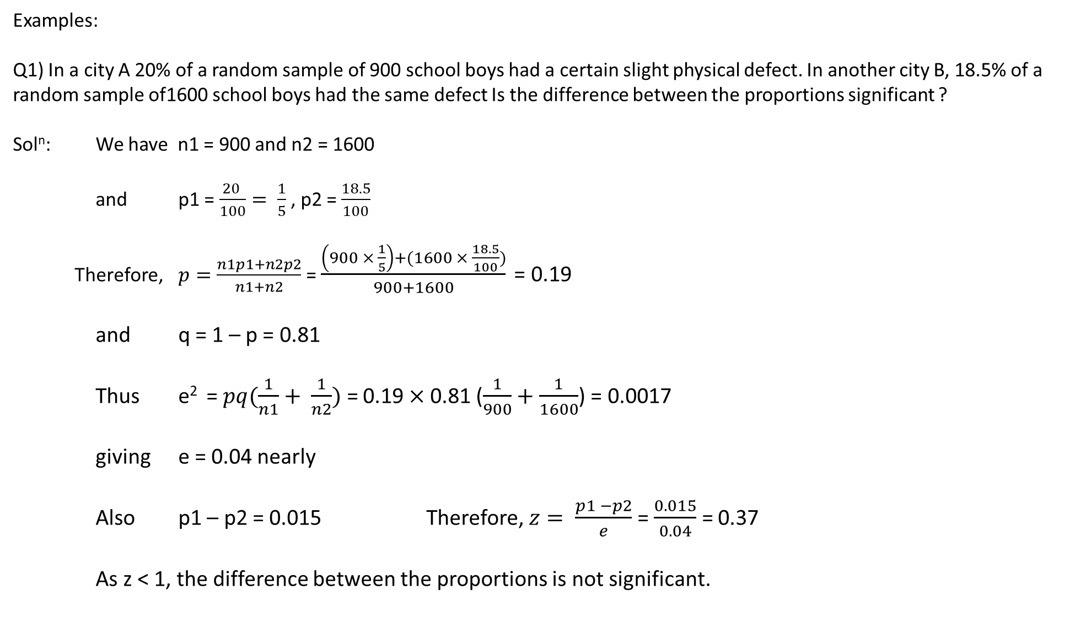
Examples:
Q1) In a city A 20% of a random sample of 900 school boys had a certain slight physical defect. In another city B, 18.5% of a random sample of1600 school boys had the same defect Is the difference between the proportions significant ?
Sol^{n}: We have n1 = 900 and n2 = 1600
and p1 = $\frac{20 }{100}= \frac{1}{5}$, p2 = $\frac{18.5}{100}$
Therefore, $p=\frac{n1p1+n2p2}{n1+n2}$ = $\frac{\left(900 × \frac{1}{5}\right)+(1600 × \frac{18.5}{100})}{900+1600}$ = 0.19
and q = 1 – p = 0.81
Thus e² = $pq(\frac{1}{n1}+ \frac{1}{n2})$ = 0.19 $×$0.81 ($\frac{1}{900}+\frac{1}{1600}$) = 0.0017
giving e = 0.04 nearly
Also p1 – p2 = 0.015 Therefore, $z= \frac{p1 −p2}{e}$ = $\frac{0.015}{0.04}$ = 0.37
As z < 1, the difference between the proportions is not significant.

Slide 11
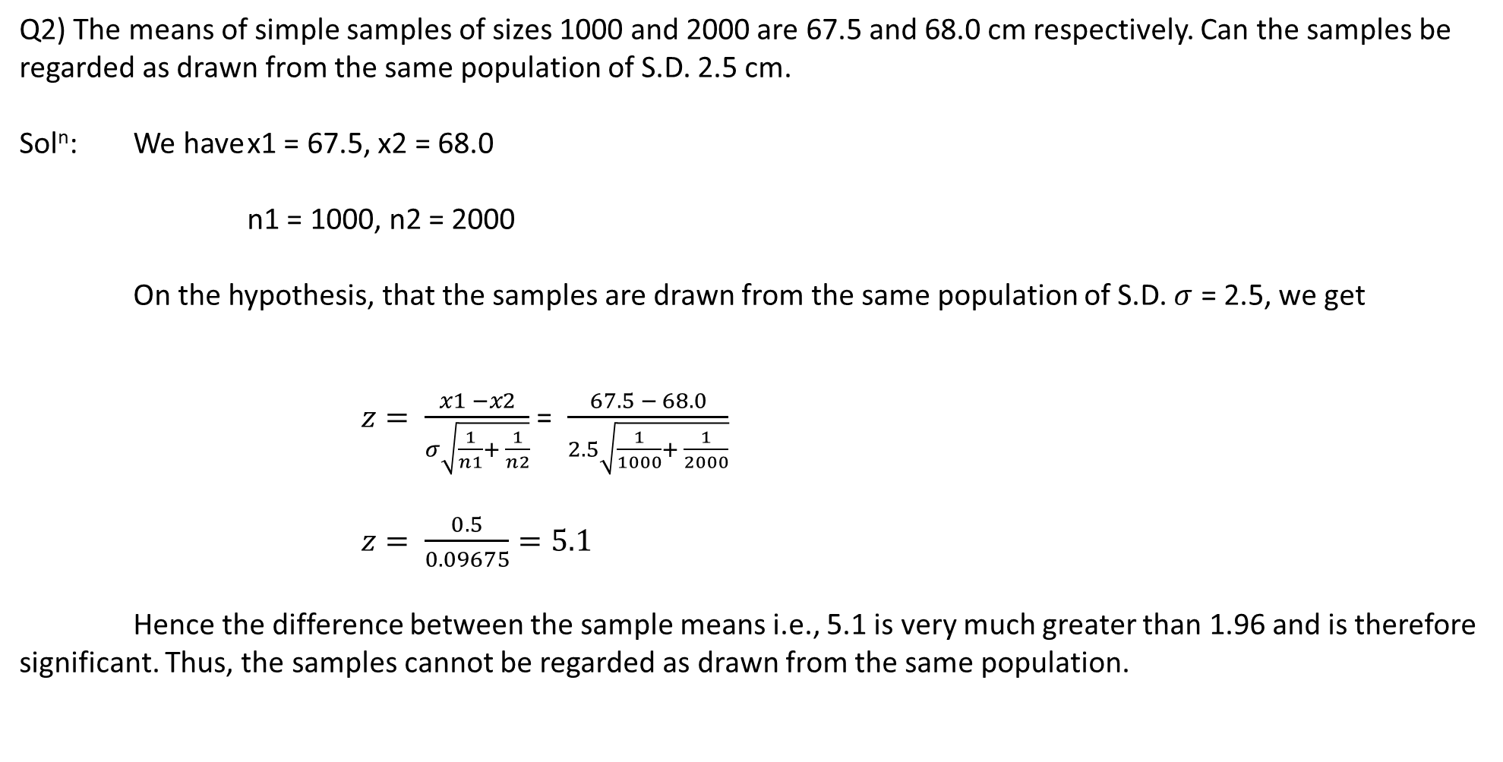
Q2) The means of simple samples of sizes 1000 and 2000 are 67.5 and 68.0 cm respectively. Can the samples be regarded as drawn from the same population of S.D. 2.5 cm.
Sol^{n}: We have x1 = 67.5, x2 = 68.0
n1 = 1000, n2 = 2000
On the hypothesis, that the samples are drawn from the same population of S.D. $σ$ = 2.5, we get
$z= \frac{x1 −x2}{σ\sqrt{\frac{1}{n1}+ \frac{1}{n2}}}$ = $\frac{67.5 − 68.0}{2.5\sqrt{\frac{1}{1000}+ \frac{1}{2000}}}$
$z= \frac{0.5}{0.09675}=5.1$
Hence the difference between the sample means i.e., 5.1 is very much greater than 1.96 and is therefore significant. Thus, the samples cannot be regarded as drawn from the same population.

Slide 12
Applications Of Large Sampling:
Sampling mostly use in research by selecting section of data (sample) which must be a representative of population and analyzing this sample and applying the result to original population, this reduces the inspection cost.
Sampling have many applications in Data Science.
Designing of Web Crawlers which optimizes search engine of web browser.
In Marketing Research to check sale of product in different areas and relation of sale in two different areas.
In Machine learning to analyze large data.
Weather forecasting uses sampling theory to predict the weather.
Predicting rate of some disease in a Large population.

Slide 13
References:
1. Higher Engineering Mathematics by
Dr. B.S. Grewal (for Questions and Introduction)
2.https://www.quora.com/
(for Applications)

